Slide 1

URMC Caregiver Project
Final Presentation
Chenwei Wu
Haosong Rao
Xuening Zhang
Meizhu Wang

Slide 2

Agenda
Project Goals & Deliverables
Achievements
Summary & Next Steps
Q&A

Slide 3
Goals & Deliverables
Predict quality of life of caregivers for older patients with advanced cancer with Machine Learning
Goal 1. Labeling Cancer Treatments:
Clean and label patients’ cancer treatments into proper class and generics
An algorithm to apply to dataset and give labels
Goal 2. Machine Learning:
Develop predictive models for caregiver physical and mental health variables, and compare results to the logistic regression in previous literature
6 models for 6 outcome variables (3 categorical, 3 continuous) & comparison with logistic(6/6)
Explain “black box” ML models 

Slide 4
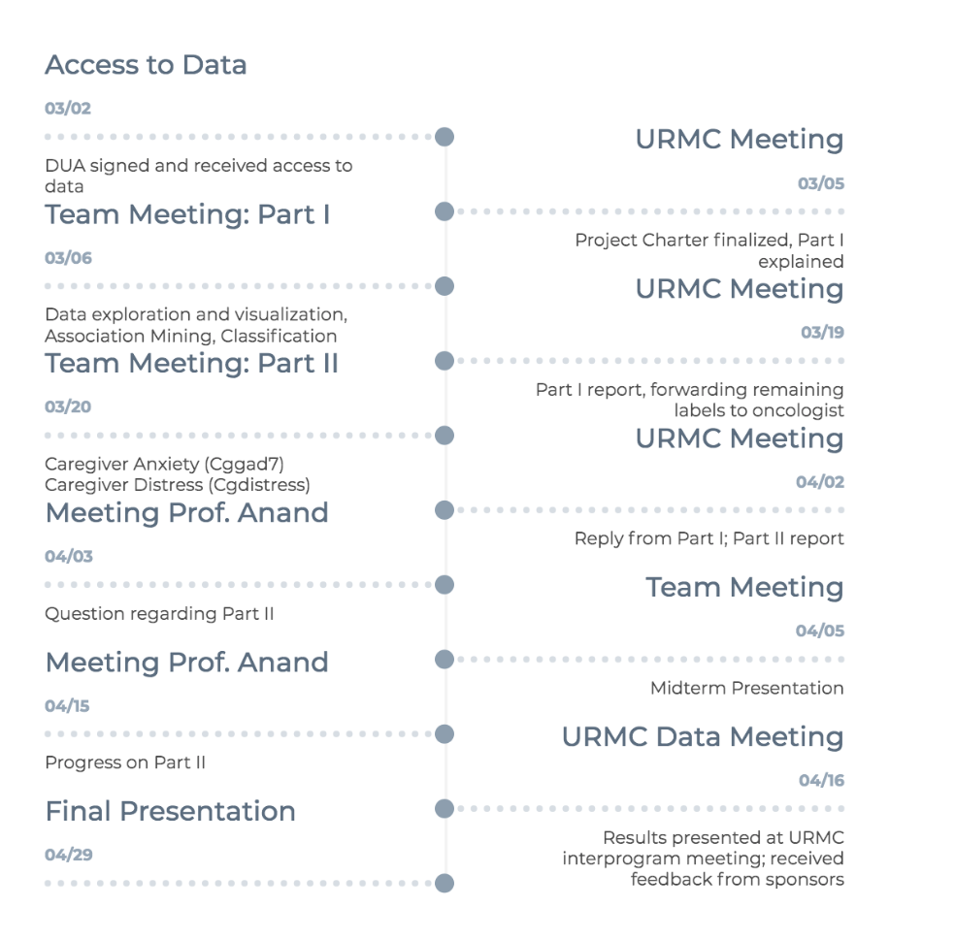
Timeline

Slide 5
Part 1 – Labeling Cancer Treatments

Slide 6
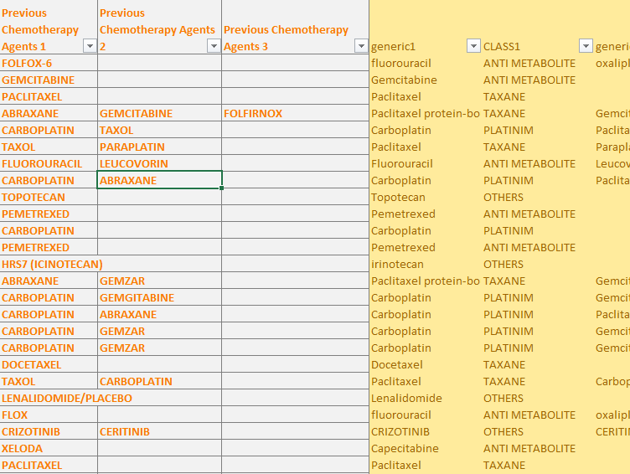
Labeling Task - Overview
Given: Reference dataset (85 rows)
New Data
(541, 368 non-empty)
Goal: Clean and label new data – What?
Folfox-6?
(100)
Some we can directly match
Abraxane?
Some need rules of association
(170)
Docetaxiieil?
(58)
Data is messy, need fuzzy match
R Crop?
(40)
No existing relevant info

Slide 7
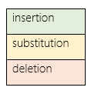
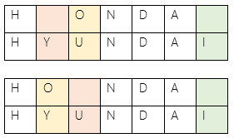
Labeling Task - Approach
Folfox-6?
Loop over data and match
Generate association rules by scanning dataset iteratively
(A,B,C) ->[1,2,3],
(B,C,D) ->[2,3,4]
Gives us (B,C)->[2,3]
Abraxane?
Docetaxiieil?
Fuzzy match by
Levenshtein
Distance

Slide 8
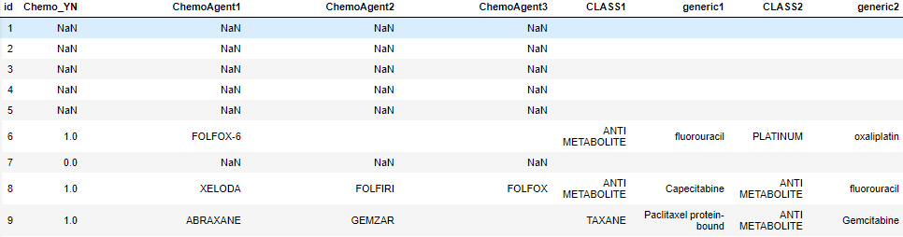
Results
Future Applications: To create a universal python algorithm for chemotherapy drugs labeling
Notes:
Implication

Slide 9
Part 2 - Predictive Models
Cgdistress(Caregiver Impaired Distress)
Cgphq2(Caregiver Impaired Depression)
SF12(Physical and Mental Composite Scores)
Cggad7(Caregiver Impaired Anxiety)
AggMent(Aggregated Mental Scores)
AggPhys(Aggregated Physical Scores)

Slide 10
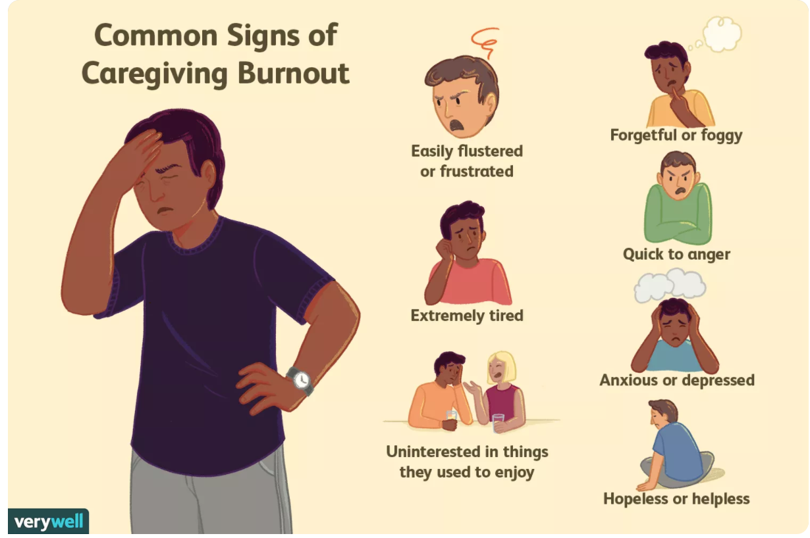
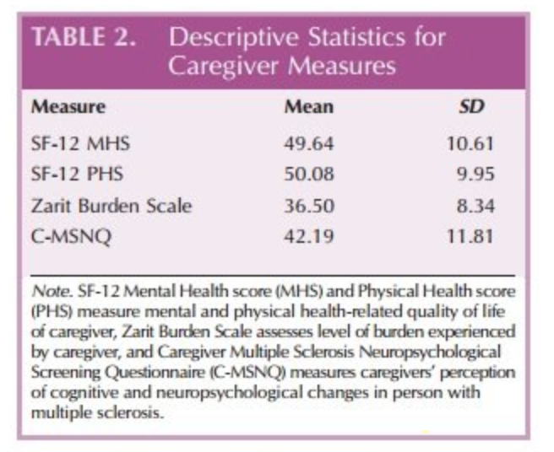
Data Exploration
Emotional Health Outcomes Overview
Statistical Outcomes Overview
Caregiver Distress
SF-12 Total Score (SF12total)
Physical Health Total Score (AGG_PHYS)
Mental Health Total Score (AGG_MENT)
Caregiver Anxiety (CGGAD7)
Caregiver Depression (CGPHQ2)

Slide 11
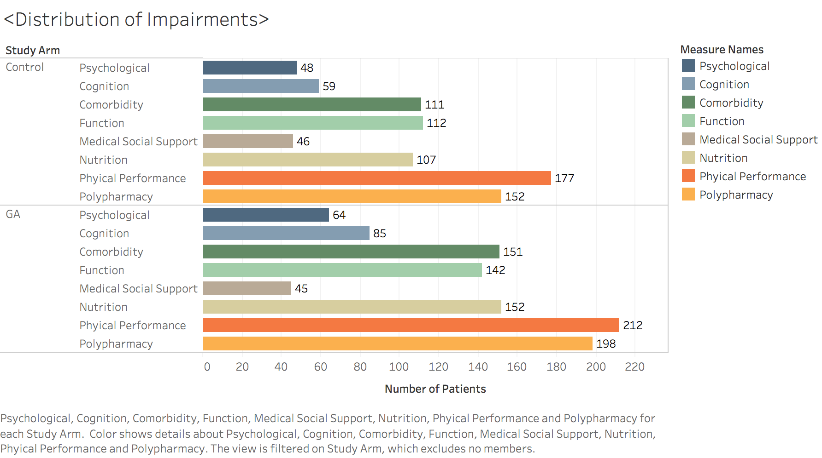
Data Exploration
Notes:
quick

Slide 12
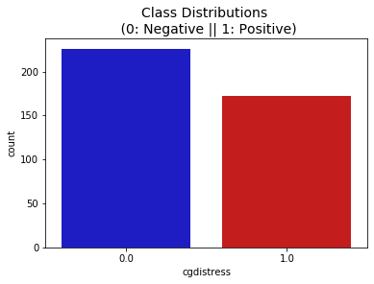
Caregiver Distress
Preprocessing:
Cgdistress has 226 zeros (Caregiver impaired distress<4) and 172 ones (distress>=4), so no data imbalance
Removed missing, one hot encoded categoricals and dropped one each to avoid multi-collinearity.
Split data 4-1 between train & test set and grid search to tune model with 5 folds Cross Validation.

Slide 13
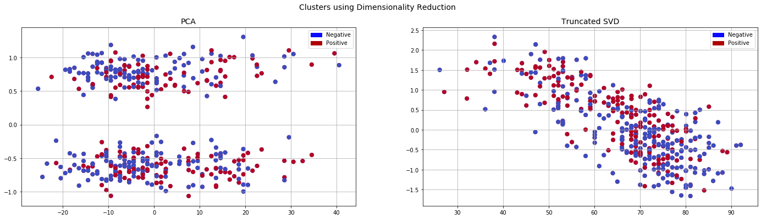
2D Representation
No clear linearly separable relationship
Guess: - ML might be better than logistic

Slide 14
Heatmap
Spearman
Correlation
Matrix Analysis:
-patient distress
-age
-gender
…

Slide 15

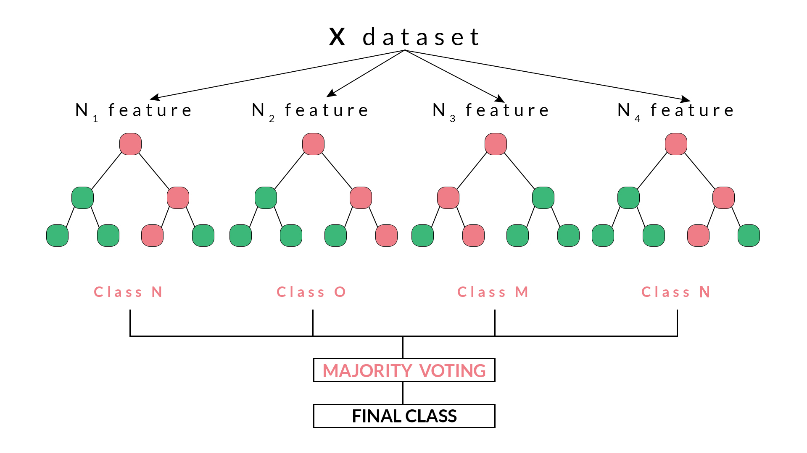
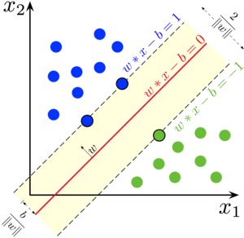
Machine Learning Methods
Implemented through scikit-learn and imbalance-learn.
Several classical machine learning methods: Logistic Regression, KNN Classifier, Random Forest ,AdaBoost, Gradient Boost and Support Vectors Machine.
e.g. Random Forest
e.g.
SVM

Slide 16
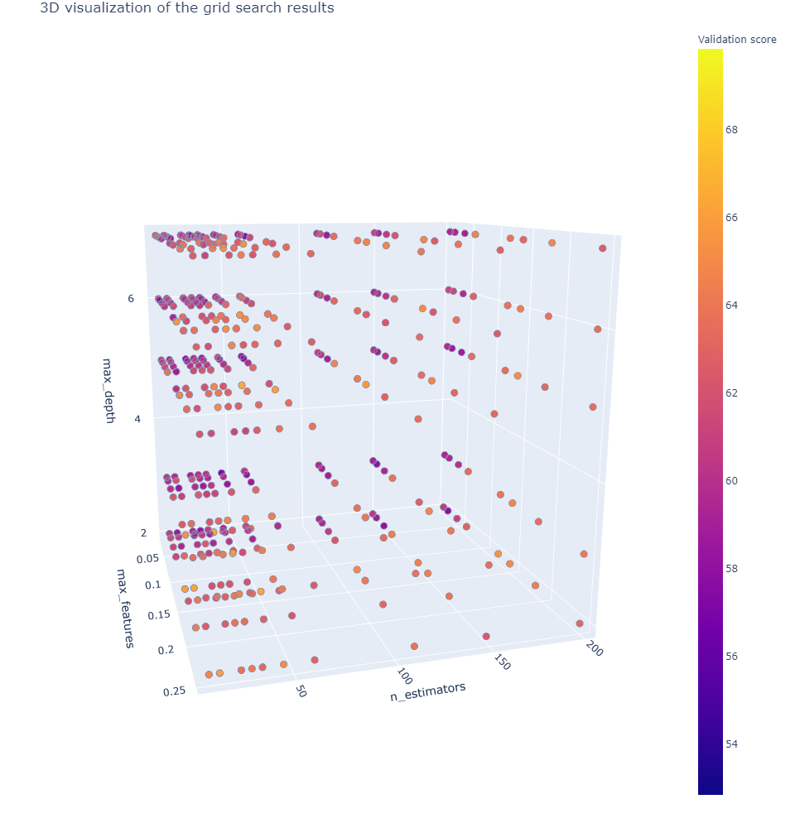
3D Grid Search for Hyperparameters
Random Forest : Green is increase in accuracy and Red is decrease.

Slide 17
Model Performance - Accuracy
Model selection based on CV Results (on ~300 data points)
Test Results for selected models (on ~100 data points)
 | RF | SVC | Logistic | KNN | Adaboost
Avg Accuracy | 0.698 | 0.67 | 0.61 | 0.62 | 0.63
Combinations | 27000 | 9891 | 841 | 300 | 1650
 | RF | SVC (RBF)
Accuracy | 0.6875 | 0.66
AUC | 0.71 | 0.68

Slide 18
Fighting Imbalanced Data (Challenges)
Cgdistress(Caregiver Impaired Distress)
Cgphq2(Caregiver Impaired Depression)

Slide 19
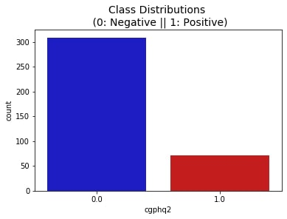
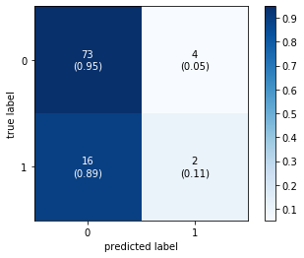
Fighting Data Imbalance
Cgphq2 has 309 zeros (Caregiver impaired depression<2) and 71 ones (Caregiver impaired depression>=2), so big data imbalance exists.
Why we care? (Similar to scam email detection)
If we don’t, the model would simply ignore the minority class (which is of more importance – here helps us to identify whether a caregiver has depression) and classify all as the majority class
Plain Logistic Regression Model
Overall accuracy (73+2)/95=78.9%
But BAD!– Class 1 accuracy only 0.11

Slide 20
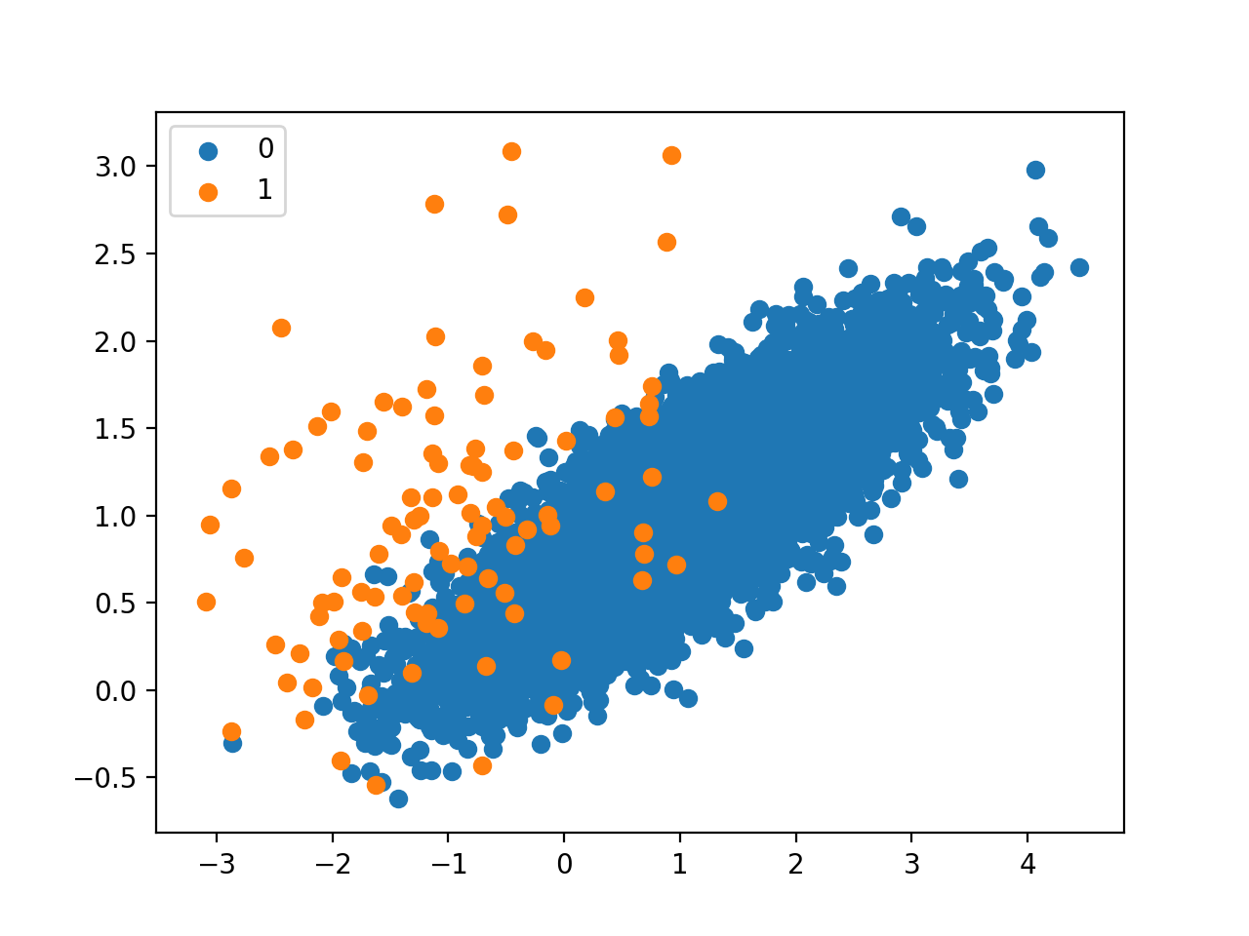
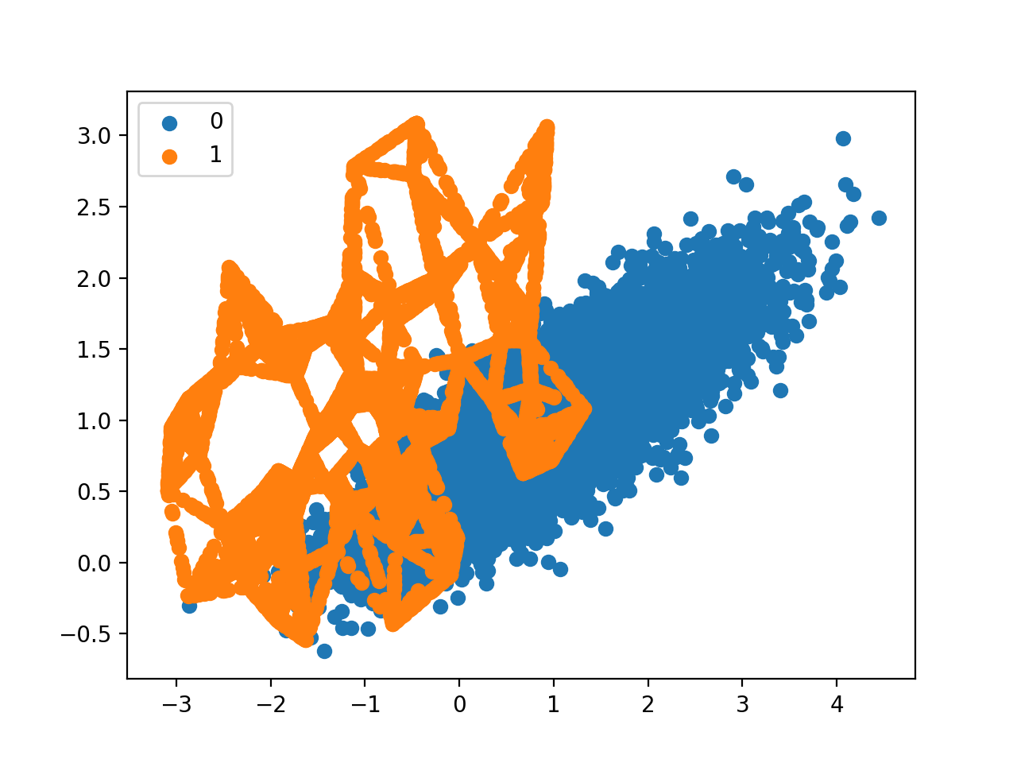
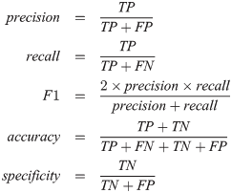
SMOTE & Change of Measures
How to deal with it?
SMOTE (oversampling by creating synthetic data points)
Downsampling (not feasible. If we downsample the 300 to 97 we will shrink the dataset size by half)
Accuracy no more feasible, instead we should use F1 score
Optimal Decision Threshold(when tpr overlap with 1-fpr)

Slide 21


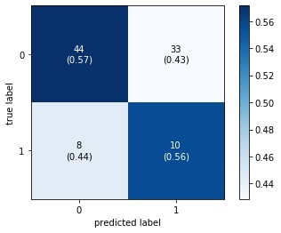
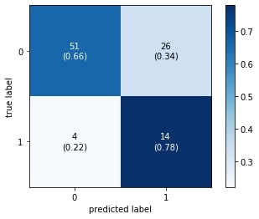

Results
Original Logistic (Accuracy)
Revised Logistic (Smote, F1)
Revised SVM

Slide 22
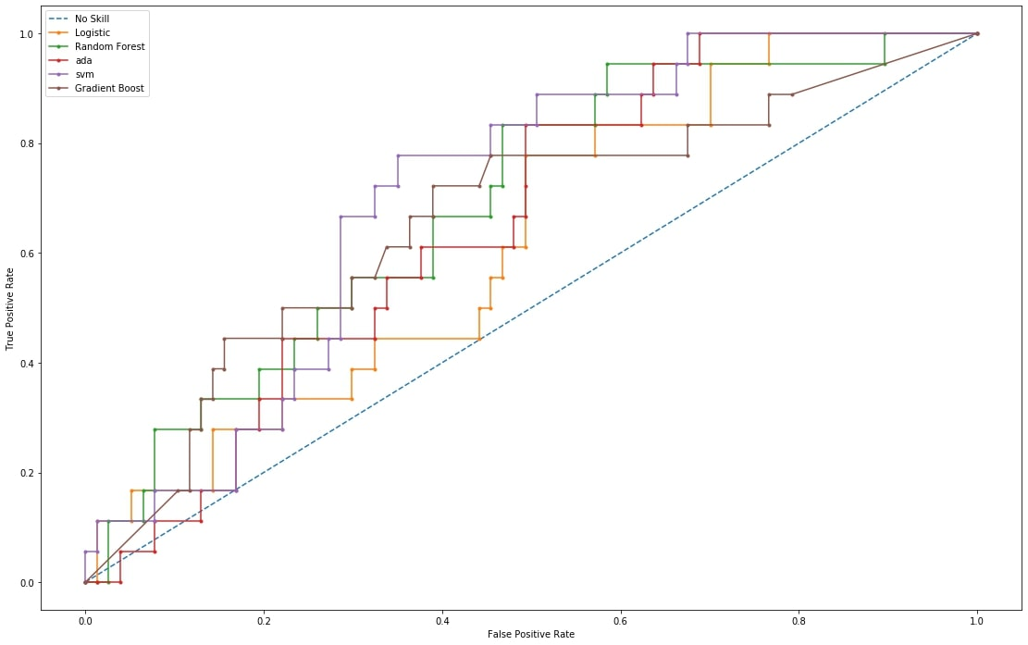
Results comparison -AUC
No Skill: ROC AUC=0.500 Ada: ROC AUC=0.657
Logistic: ROC AUC=0.623 SVM: ROC AUC=0.707
RF: ROC AUC=0.688 Gb: ROC AUC=0.661

Slide 23
Transforming Regression into Classification
Cgdistress(Caregiver Impaired Distress)
Cgphys2(Caregiver Impaired Physical)
Cggad7(Caregiver Impaired Anxiety)
SF12(Physical and Mental Health Composite Scores)
AggMent(Aggregated Mental Scores)
AggPhys(Aggregated Physical Scores)

Slide 24
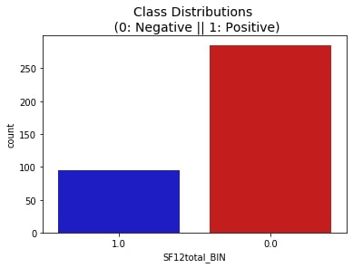
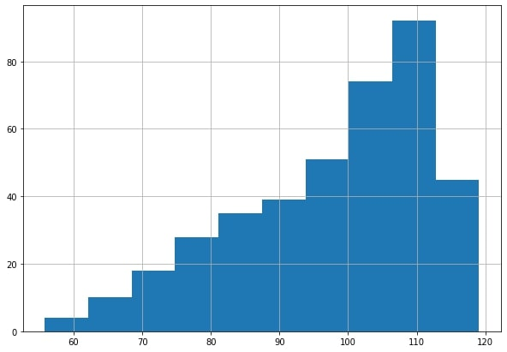
SF12 Total Score
Due to the all categorical nature and lack of predicting power of the predictors, we found it hard to reduce RMSE (9-10) during regression task. We consulted Prof Xu and discretized continuous outcome variable, cutting by first 25 quantile. This leads us to a similar imbalanced classification like previous tasks.
88

Slide 25
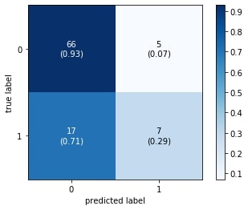
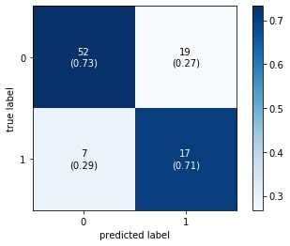
SF12 Total Score
Original Logistic Regression
Revised Random Forest

Slide 26
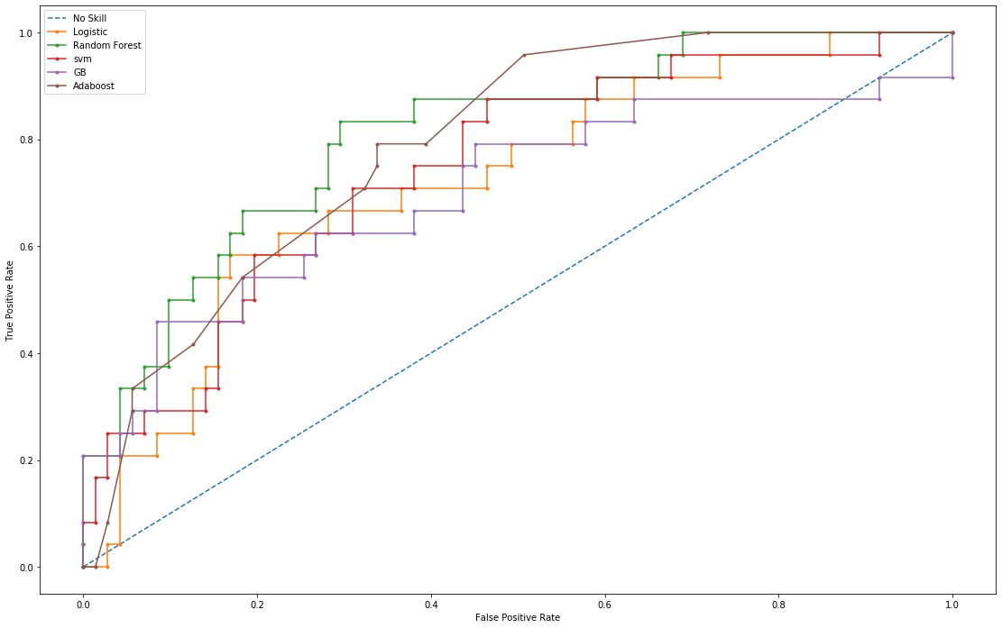
SF12 Total Score
No Skill: ROC AUC=0.500
Logistic: ROC AUC=0.722
svm: ROC AUC=0.745
gb: ROC AUC=0.702
Adaboost: ROC AUC=0.789
RF: ROC AUC=0.809

Slide 27
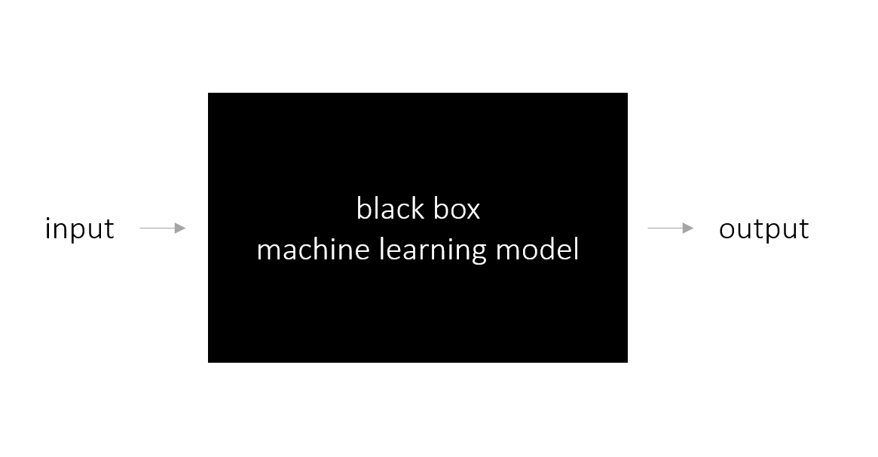
Explaining ML Results
LIME(Local Interpretable Model-agnostic Explanation) – What’s Inside the Blackbox?
LIME modifies a single data sample by tweaking the feature values and observes the resulting impact on the output

Slide 28
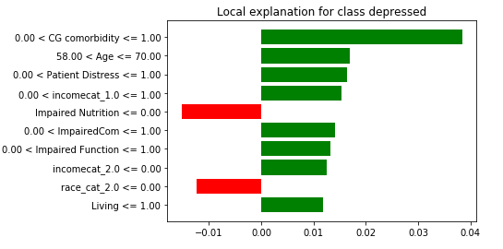
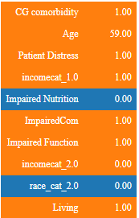
LIME on Depression, SVM - rbf
Example: A Caregiver correctly diagnosed depressed by model
Top ten impacts:
Help Clinicians understand factors that might lead to distress and take preventive measures

Slide 29
Summary
Labeling
Data Imbalance
Why model better than logistic?
Explaining Black Box with LIME
We also ran prediction on other 3 and saw good results (See appendix)
Making documentation & reports
Next Steps

Slide 30
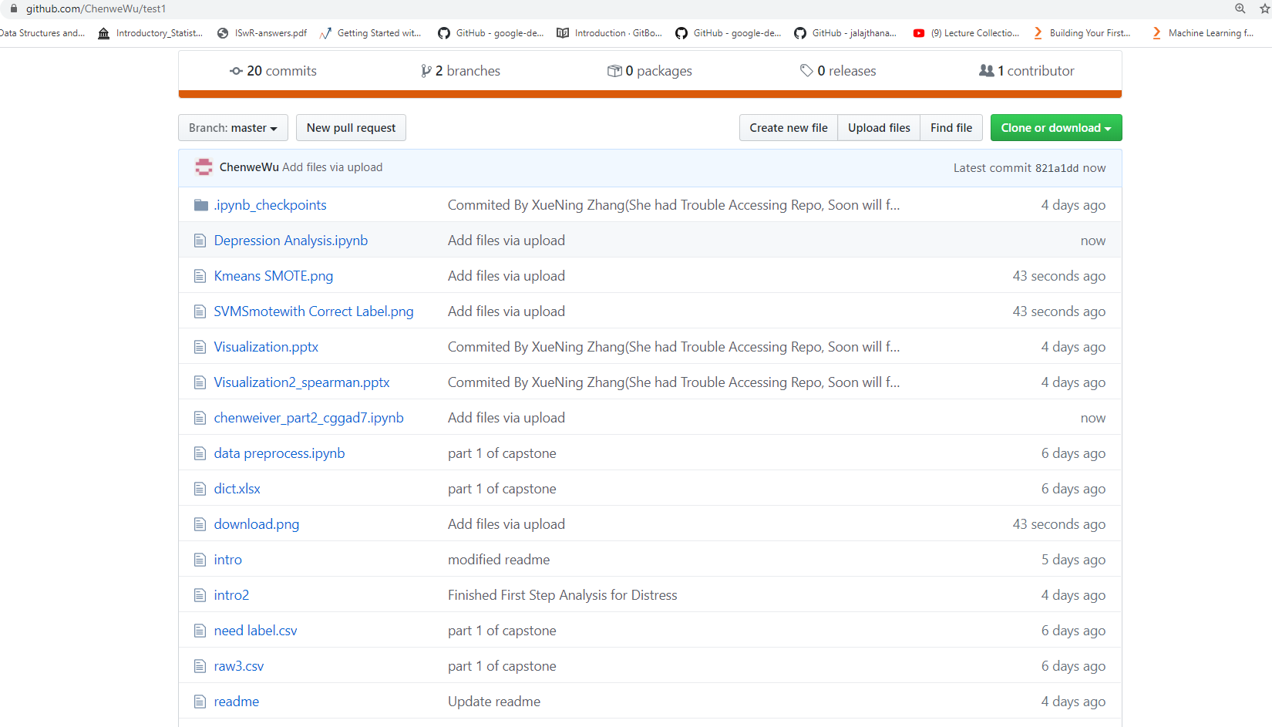
Github Repo (without Data) /ChenweWu/test1

Slide 31
Sponsor Feedback -from Professor Xu
Great progress so far, I especially love the SMOTE which helps the data imbalance a lot.
As next step, we need to test more algorithms on the test set. Ensemble learning like Superlearner might be a good option
Also, I would like to see variable importance for both outcomes.
Thanks for all your hard work! Great team to work with!

Slide 32
Questions and Feedback
Thank you!
Dr. Anand
Dr. Xu
Dr. Ramsdale
Dr. Culakova
Dr. Kadambi
Mostafa Mohammad
Amita Patil
Lee Kehoe
Megan Wells
Sandy Plumb

Slide 33
Appendix Below

Slide 34
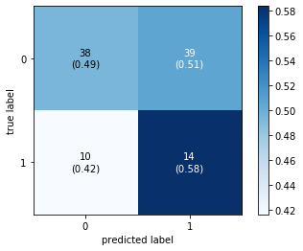
Change of measures
You might think, why don’t we just train the model based on class 1 accuracy? That would ignore class 0 and do the opposite harm
we shouldn’t let our model be skewed by true negatives and need to prioritize true positives.
Then we searched best models based on F1, the weighted precision and recall.
We also looked at models’ precision vs recall tradeoff to determine a good decision threshold value. (not 0.5 always)

Slide 35
Anxiety Results
Performance | Logistic Revised | SVM Revised
AUC | 0.63 | 0.73
Class 0 Accuracy | 0.56 | 0.70
Class 1 Accuracy | 0.58 | 0.75

Slide 36
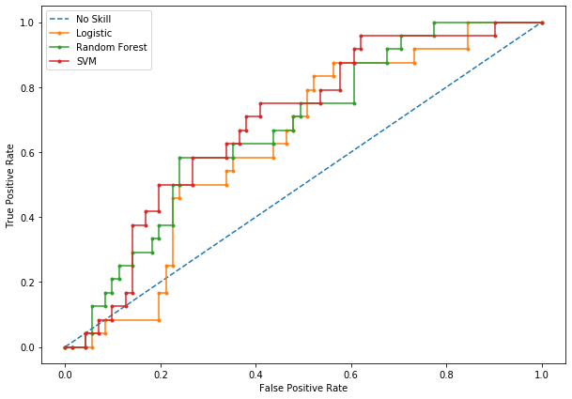
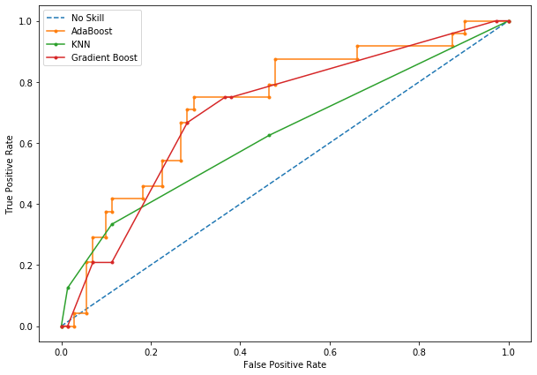
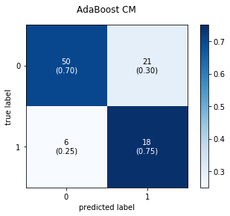
Physical Score Results
AdaBoost: ROC AUC=0.726
KNN: ROC AUC=0.627
Gradient Boost: ROC AUC=0.705
Logistic: ROC AUC=0.629
RF: ROC AUC=0.673
SVM: ROC AUC=0.690

Slide 37
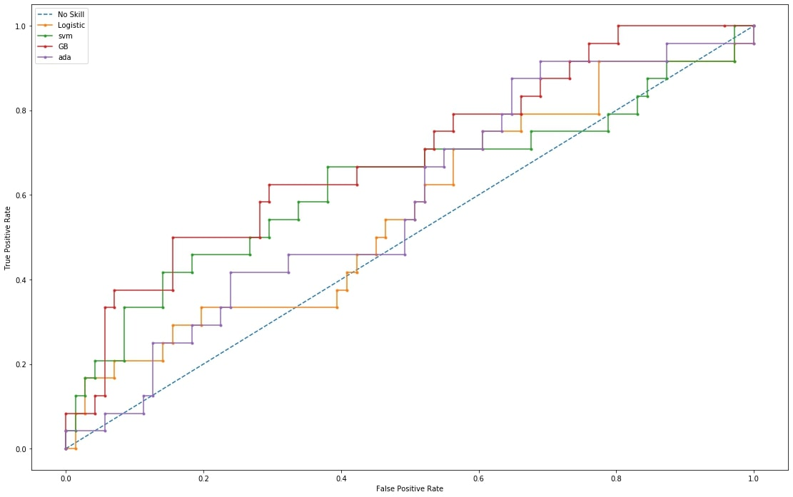
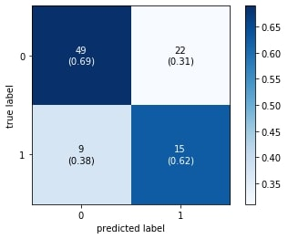
Mental Score Results
Gb CM
No Skill: ROC AUC=0.500 gb: ROC AUC=0.691
Logistic: ROC AUC=0.562 Ada: ROC AUC=0.586
svm: ROC AUC=0.627

